Slide 1
AI – from now to the future
Yi Zhou

Slide 2
  Content
    AI – a brief introduction
    Connectionism, Behaviourism, Symbolism
    Where are we?
    Concluding remarks

Slide 3
  Content
    AI – a brief introduction
    Connectionism, Behaviourism, Symbolism
    Where are we?
    Concluding remarks

Slide 4



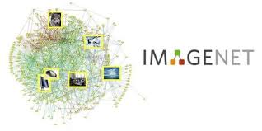
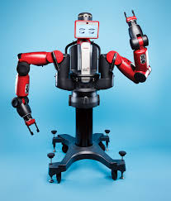


AI – Applications

Slide 5
AI - Approaches
logic programming
expert system
default logic
propositional logic
ontology
SVM
first-order logic
answer set
Bayesian network
SOAR
neural network
situation calculus
evolutionary computation
GPS
decision theory
planning
game theory
NLP
CSP
MDP
……………….

Slide 6
AI - Inspirations
logic
psychology
social science
cognitive science
neuro- science
statistics
biology
economics
philosophy
of mind

Slide 7

横看成岭侧成峰
远近高低各不同
不识庐山真面目
只缘身在此山中

Slide 8


The Nature of AI
Intelligence: the ability to acquire and apply knowledge and skills.
Cognition: the mental action or process of acquiring knowledge and understand through thought, experience and the senses.
—— Oxford Dictionary
representation
Artificial Intelligence
  Encode/Represent Knowledge
  Acquire/Learn Knowledge
  Apply/Reason Knowledge
knowledge
reasoning
learning

Slide 9
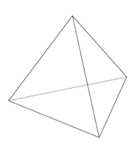
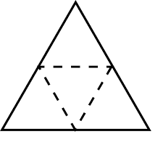
AI: 3 Essential Tasks
AI
AI
representation
representation
knowledge
learning
reasoning
reasoning
learning

Slide 10
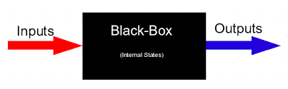
AI: 3 Essential Tasks
    knowledge representation
        How to model inputs, outputs and internal states?
    knowledge reasoning
        How to derive outputs from inputs through internal states?
    knowledge learning
        How to engineer the internal states (by given
        correct samples of input-output pairs)?

Slide 11
  Content
    AI – a brief introduction
    Connectionism, Behaviourism, Symbolism
    Where are we?
    Concluding remarks

Slide 12
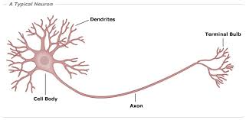
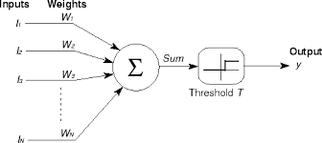
Connectionism – Inspiration

Slide 13
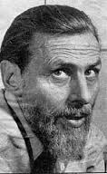
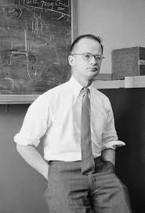
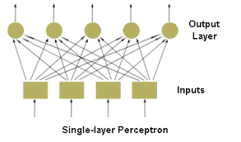
Connectionism – Origin

Slide 14




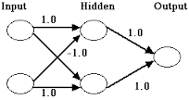
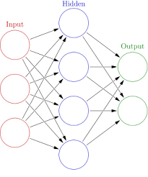
Connectionism – 1st Winter

Slide 15




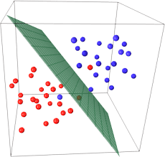
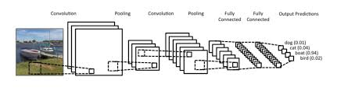
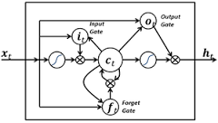
Connectionism – 2nd Winter

Slide 16

Connectionism – Applications

Slide 17
Connectionism – RRL
    knowledge representation
        How to model inputs, outputs and internal states?
        (deep) (convolutional, recurrent) neural network
    knowledge reasoning
        How to derive outputs from inputs through internal states?
        forward propagation
    knowledge learning
        How to engineer the internal states (by given correct samples of input-output pairs)?
        backward propagation

Slide 18
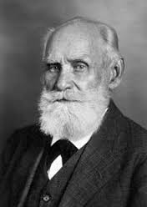
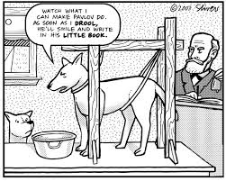
Behaviourism – Inspiration

Slide 19
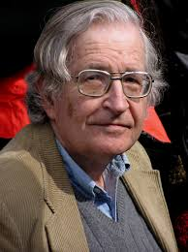
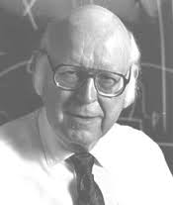
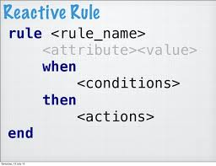
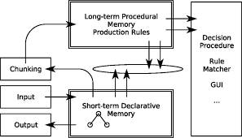
Behaviourism – Early Approaches

Slide 20

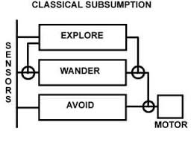
Behaviourism – 1st Spring

Slide 21
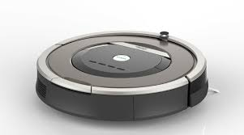
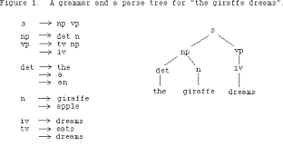
Behaviourism – Applications

Slide 22
Behaviourism – RRL
    knowledge representation
        How to model inputs, outputs and internal states?
        (multi-layer) reactive rules
    knowledge reasoning
        How to derive outputs from inputs through internal states?
        reaction
    knowledge learning
        How to engineer the internal states (by given correct samples of input-output pairs)?
        hand-coded

Slide 23
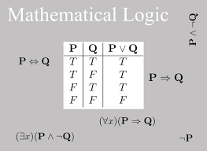
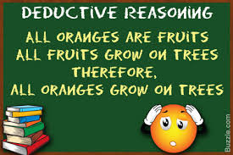
Symbolism 1.0 – Inspiration

Slide 24

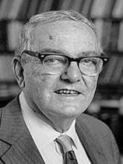
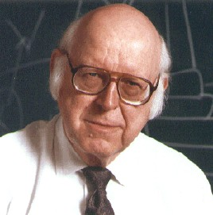



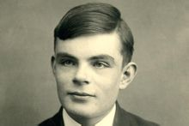
Symbolism – “Turing” Award

Slide 25

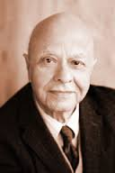





Symbolism – IJCAI Award for Research Excellence

Slide 26
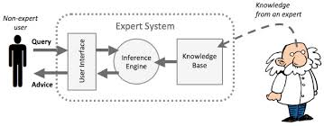
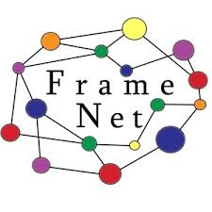

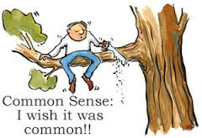

Symbolism 1.0 – 1st Winter
ConceptNet5

Slide 27



Symbolism 1.5 – 1st Spring
Using machine learning to mine knowledge from dark data
Automated Knowledge
Base Construction
Automated Knowledge
Base Completion
Semantic Parsing

Slide 28
Symbolism 1.5 – Applications

Slide 29
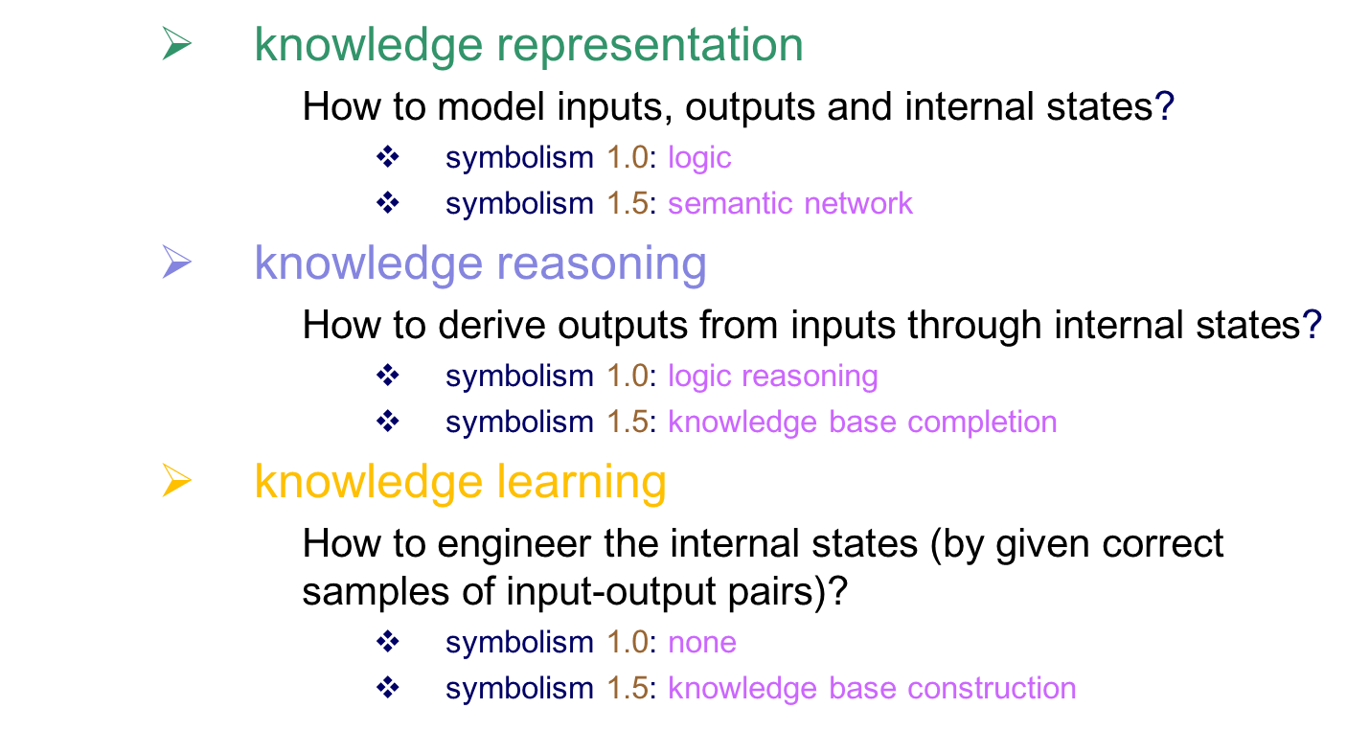
Symbolism – RRL

Slide 30
  Content
    AI – a brief introduction
    Connectionism, Behaviourism, Symbolism
    Where are we?
    Concluding remarks

Slide 31
Measuring AI - Connectionism
    knowledge representation
        Pres: all functions in principle
        Cons: case by case in practice
        Overall: 2
    knowledge reasoning
        Pres: simulation/approximation
        Cons: deduction/logical reasoning
        Overall: 2
    knowledge learning
        Pres: learning parameters
        Cons: learning knowledge
        Overall: 4
representation
AI
reasoning
learning

Slide 32
Measuring AI - Behaviourism
    knowledge representation
        Pres: low level
        Cons: high level
        Overall: 2
    knowledge reasoning
        Pres: efficient
        Cons: not expressive
        Overall: 4
    knowledge learning
        Pres:
        Cons: limited learning
        Overall: 1
representation
AI
reasoning
learning

Slide 33
Measuring AI – Symbolism 1.0
    knowledge representation
        Pres: logic symbols
        Cons: extensibility
        Overall: 4
    knowledge reasoning
        Pres: sound, complete
        Cons: slow
        Overall: 2
    knowledge learning
        Pres:
        Cons: limited learning
        Overall: 1
representation
AI
reasoning
learning

Slide 34
Measuring AI – Symbolism 1.5
    knowledge representation
        Pres: triplet
        Cons: extensibility, complicated form
        Overall: 3
    knowledge reasoning
        Pres: query
        Cons: deduction, explanation
        Overall: 2
    knowledge learning
        Pres: simple knowledge
        Cons: complicated knowledge
        Overall: 3
representation
AI
reasoning
learning

Slide 35
AI – the Future
representation
AI
reasoning
learning
    from data science to knowledge science
        knowledge representation
        knowledge reasoning
        knowledge learning

Slide 36
6E: What we need
Elegant
Extensible
Expressive
Efficient
Educable
Evolvable
representation
AI
reasoning
learning

Slide 37
  Content
    AI – a brief introduction
    Connectionism, Behaviourism, Symbolism
    Where are we?
    Concluding remarks

Slide 38
Concluding Remarks
    Knowledge representation, reasoning and learning
    connectionism, symbolism and behaviourism
    The future of AI: 6E’s

Slide 39

Thank you!

